Slide 1
Precise Recording of Vibration Onset

Slide 2
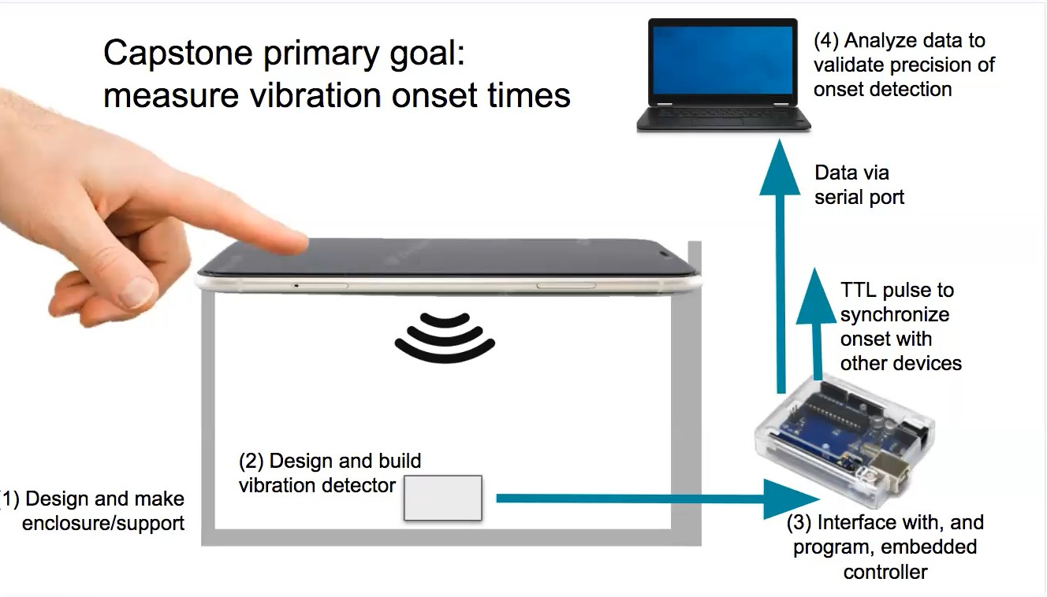

Slide 3
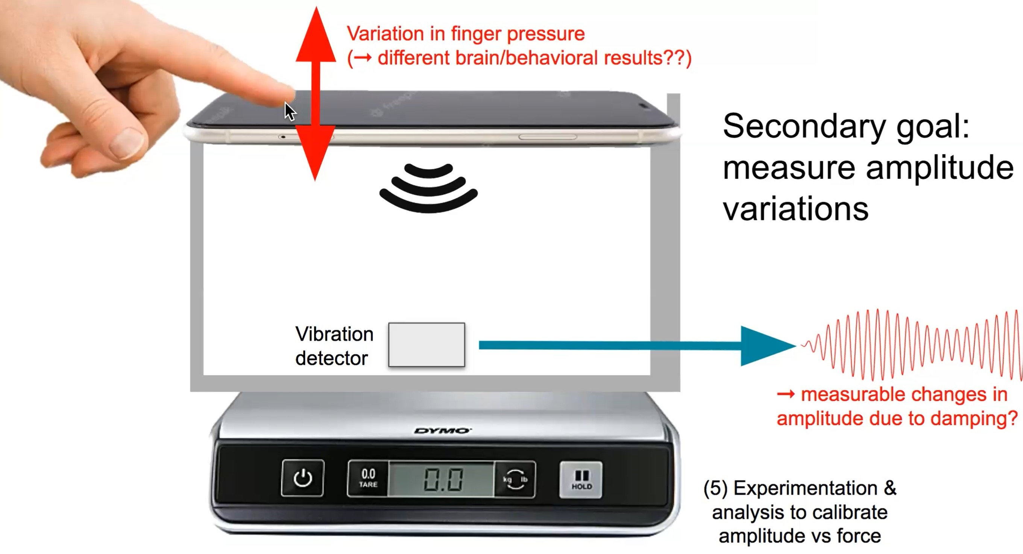

Slide 4
Piezo
A piezo vibration sensor, also known as a piezoelectric vibration sensor or piezoelectric accelerometer, is a device that uses the piezoelectric effect to measure vibrations, accelerations, and mechanical forces. The piezoelectric effect is a phenomenon in which certain materials generate an electrical charge in response to mechanical stress or deformation. In the case of piezo vibration sensors, when they experience vibration or acceleration, they generate a voltage signal proportional to the applied force or acceleration.

Slide 5
